Slide 1
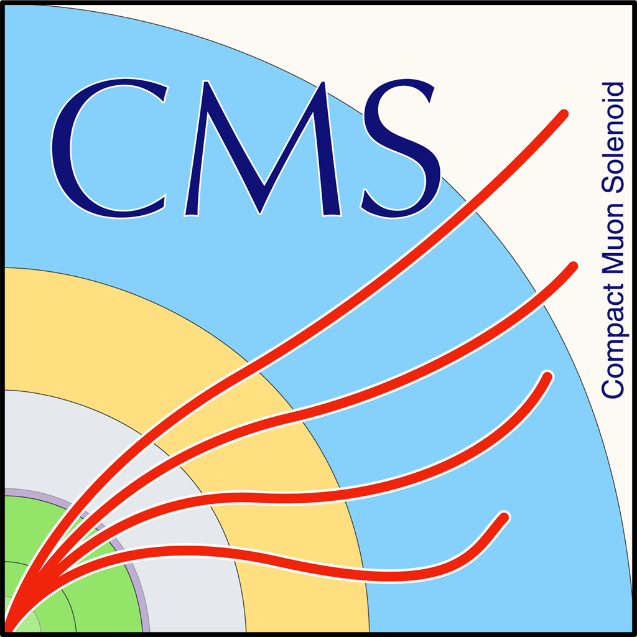

Mass Fit results and btagging efficiency
George Bakas, Ioannis Papakrivopoulos

Slide 2
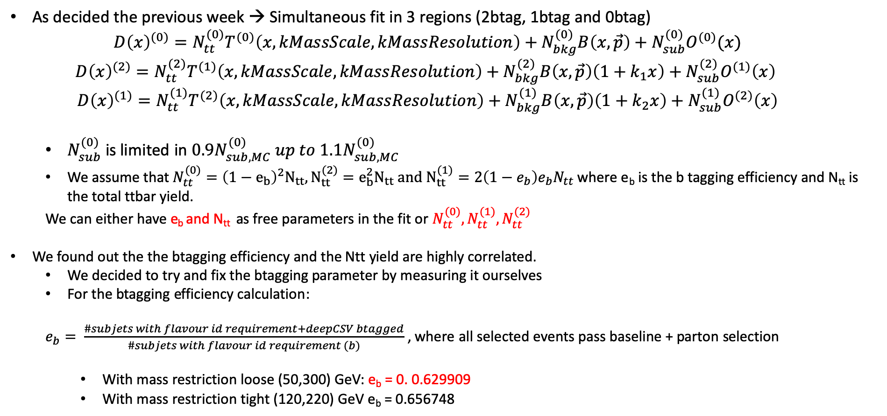
Simultaneous Fit in 3 regions
As decided the previous week → Simultaneous fit in 3 regions (2btag, 1btag and 0btag)
$$D{\left(x\right)}^{(0)}=N_{tt}^{(0)}T^{(0)}\left(x, kMassScale, kMassResolution\right)+N_{bkg}^{(0)}B\left(x,\vec{p}\right)+N_{sub}^{(0)}O^{(0)}(x)$$
$$D{\left(x\right)}^{(2)}=N_{tt}^{(2)}T^{(1)}\left(x,kMassScale, kMassResolution\right)+N_{bkg}^{(2)}B\left(x,\vec{p}\right)\left(1+k_{1}x\right)+N_{sub}^{(2)}O^{(1)}\left(x\right)$$
$$D{\left(x\right)}^{(1)}=N_{tt}^{(1)}T^{(2)}\left(x,kMassScale, kMassResolution\right)+N_{bkg}^{(1)}B\left(x,\vec{p}\right)\left(1+k_{2}x\right)+N_{sub}^{(1)}O^{(2)}\left(x\right)$$
$N_{sub}^{(0)}$ is limited in $0.9N_{sub,MC}^{(0)} up to 1.1N_{sub,MC}^{(0)}$
We assume that $N_{tt}^{(0)}={\left(1−e_{b}\right)}^{2}N_{tt}, N_{tt}^{(2)}=e_{b}^{2}N_{tt} and N_{tt}^{(1)}=2\left(1−e_{b}\right)e_{b}N_{tt}$ where e_{b} is the b tagging efficiency and N_{tt} is the total ttbar yield.
We can either have e_{b} and N_{tt} as free parameters in the fit or $N_{tt}^{(0)},N_{tt}^{(1)},N_{tt}^{(2)}$
We found out the the btagging efficiency and the Ntt yield are highly correlated.
We decided to try and fix the btagging parameter by measuring it ourselves
For the btagging efficiency calculation:
$e_{b}= \frac{\#subjets with flavour id requirement+deepCSV btagged}{\#subjets with flavour id requirement (b)}$ , where all selected events pass baseline + parton selection
With mass restriction loose (50,300) GeV: e_{b} = 0. 0.629909
With mass restriction tight (120,220) GeV e_{b} = 0.656748

Slide 3
Overview of SR_{A} region
Extension of Signal Region → SR_{A} = SR – Mass Selection cuts
Selection:
Jet Matching
Parton cuts:
partonPt[0],[1] > 400
|partonEta[0],[1]| < 2.4
mTTbarParton > 1000
Reco cuts:
nJets > 1
nLeptons = 0
mJJ > 1000
jetPt[0],[1] > 400
|jetEta[0],[1]| < 2.4
bTagging cut (mediugm WP deepCSV) (2016: 0.6321, 2017: 0.4941, 2018: 0.4184)
Tagger cut (top Tagger) (2016: 0.2, 2017:0.0, 2018: 0.1)
TriggerBit

Slide 4
Purpose of this presentation
We calculate and present the fit result in two ways:
Fix the e_{b} parameter at a certain value → This will be Method A
Let the e_{b} parameter free on the interval [0.5,0.8] → This will be Method B
Results:
Method A: r = 0.85347 with Ntt expected (MC) = 16351 and Ntt observed = 13955
Method B: r = 1.02045 with Ntt expected (MC) = 16351 and Ntt observed = 16686
Floating Parameter FinalValue +/- Error
-------------------- --------------------------
btagEff 5.6029e-01 +/- 1.17e-02
kMassResol 9.6557e-01 +/- 2.29e-02
kMassScale 1.0020e+00 +/- 1.60e-03
kQCD_1b 5.8296e-03 +/- 4.50e-04
kQCD_2b 7.7313e-02 +/- 4.98e-02
nFitBkg_0b 4.5269e+03 +/- 5.63e+01
nFitBkg_1b 2.3159e+03 +/- 4.02e+02
nFitBkg_2b 2.3726e+02 +/- 4.25e+01
nFitQCD_0b 8.7019e+04 +/- 4.15e+02
nFitQCD_1b 2.8973e+04 +/- 3.93e+02
nFitQCD_2b 2.9980e+03 +/- 1.43e+02
nFitSig 1.6686e+04 +/- 6.56e+02
Floating Parameter FinalValue +/- Error
-------------------- --------------------------
kMassResol 9.2150e-01 +/- 2.07e-02
kMassScale 1.0023e+00 +/- 1.60e-03
kQCD_1b 6.3680e-03 +/- 4.58e-04
kQCD_2b 5.9385e-02 +/- 3.48e-02
nFitBkg_0b 4.5269e+03 +/- 4.25e+01
nFitBkg_1b 2.3356e+03 +/- 2.73e+02
nFitBkg_2b 2.0703e+02 +/- 2.32e+01
nFitQCD_0b 8.8323e+04 +/- 3.13e+02
nFitQCD_1b 3.0542e+04 +/- 2.62e+02
nFitQCD_2b 2.8400e+03 +/- 1.55e+02
nFitSig 1.3955e+04 +/- 3.69e+02

Slide 5
Simultaneous Fit in 3 regions Method A
Signal Region (2btag)
Control Region (0btag)
Result of the template fit on data in SR and CR. The red line shows the tt contribution, the green line shows the QCD, and the brown line shows the subdominant backgrounds

Slide 6
Simultaneous Fit in 3 regions Method B
Signal Region (2btag)
Control Region (0btag)
Result of the template fit on data in SR and CR. The red line shows the tt contribution, the green line shows the QCD, and the brown line shows the subdominant backgrounds

Slide 7
Simultaneous Fit in 3 regions (1btag Region)
Method A
Method B

Slide 8
b-tagging Purity
Distribution of the parton flavor for each b tagged subjet.

Slide 9
b-tagging
Efficiency

